Slide 1
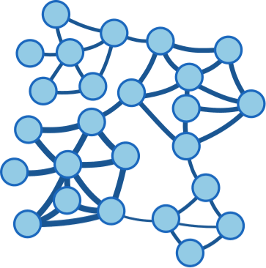







TDA
Original data
(defined in n-dimension)
Data samples
(n-dimension)
Filtered projection
PCA
UMAP
t-SNE
Pre-
Filtering
Covering
Clustering
Keep the projection transformation for mapping new data samples into the 2D space derived from the original dataset
2D representation of original data
Original data
Create Cover based on original data
Create node graph from the Covering bins
New sample
Mapping new sample inside the using the projection transformation

